Slide 1


Introduction to
Robotic Process Automation
The MailMinder Bot
Your Register No: 2207011059
Name:Deepthi P
Designation and Department:CSE A

Slide 2
Abstract
The MailMinder Bot is an advanced Robotic Process Automation (RPA) solution designed to streamline email management. Developed using UiPath, it automates email parsing, key detail extraction (e.g., payment details), attachment handling, and report generation. By integrating regex-based extraction and structured output storage, the bot ensures accurate, efficient, and consistent email processing, significantly reducing manual effort.

Slide 3
Need for the Proposed System
Problem Statement
Manual email handling, especially in organizations or academic settings, involves numerous repetitive tasks such as:
Parsing emails to extract critical information.
Downloading and organizing attachments.
Consolidating extracted information into reports.
Challenges:
High risk of human error in handling complex or large datasets.
Inefficiency in managing bulk email volumes due to manual processing.
Lack of consistency in extracting key details like payment information or deadlines.
.

Slide 4
Advantages of the Proposed System
Automation of Tedious and Repetitive Tasks
The MailMinder Bot automates repetitive email management task efforts.
High Accuracy in Key Detail Extraction
Using regex-based techniques, the system accurately extracts essential details like invoice numbers and due dates.
Systematic Organization of Attachments and Data
Attachments are downloaded and stored in organized directories, and extracted data is structured systematically
Structured Report Generation for Decision-Making
The bot generates well-organized Excel reports with key insights, such as deadlines and payment details
Reduction in Manual Effort and Increased Efficiency
By automating email processing, the system reduces the manual workload

Slide 5
Literature Survey
Paper 1: "Automated Email Management Systems"
Authors: Smith, J., & Taylor, R.
Summary:
This paper explores the development and deployment of automated systems for managing email workflows in corporate environments. It highlights the role of automation in streamlining repetitive tasks, such as email sorting, content parsing, and data extraction, to improve operational efficiency.
Advantages: Demonstrates significant improvements in task automation and operational efficiency by reducing manual intervention.
Disadvantages: The system is limited to specific email use cases and lacks comprehensive data validation mechanisms, which could affect reliability in diverse applications.

Slide 6
Literature Survey
Paper 2: "Regex-Based Information Extraction"
Authors: Lee, H., & Nguyen, T.
Summary:
This paper examines the use of regular expressions (regex) as a robust method for extracting structured data from unstructured text sources, such as emails and documents. The research discusses the versatility of regex-based extraction techniques and their applications across various industries.
Advantages: Highly effective in identifying and extracting structured data, such as dates, payment details, and invoice numbers, from unstructured text.
Disadvantages: Performance is heavily dependent on predefined patterns and the quality of input data, which may limit its adaptability to unforeseen formats or errors.

Slide 7
Main Objective
The objective of MailMinder is to automate the process of efficiently parsing incoming emails, extracting key information such as payment details, invoice numbers, due dates, and other relevant data points, while managing attachments like invoices or receipts. By leveraging Robotic Process Automation (RPA) technologies, MailMinder aims to streamline the workflow of identifying, categorizing, and processing emails, reducing manual intervention. The bot will also generate structured reports, move important emails to designated folders, and store extracted data for easy access, ensuring seamless email management and data extraction for business operations.

Slide 8
Architecture
Input:
• User credentials to access the IMAP server.
• Emails fetched from the server and their respective attachments.
Process:
• Input Layer: Handles communication with the email server.
• Processing Layer: Parses emails, extracts information, processes
attachments, and validates data.
• Storage Layer: Stores attachments, organizes data, and creates reports.
• Output Layer: Notifies users and provides a report viewer for
administrators.
Output:
• Validated data is stored in a structured format (Excel or database).
• Notifications are sent to users.
• Admins access detailed reports for oversight.

Slide 9
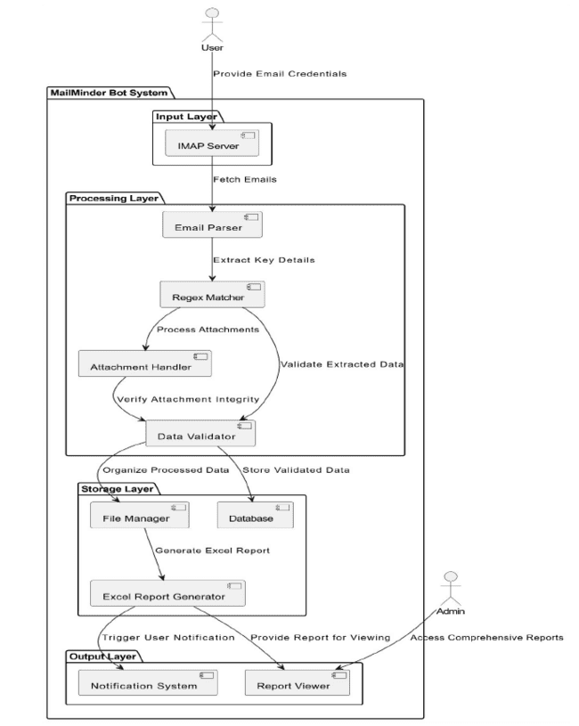

Slide 10
System Requirements
Hardware:
Processor: Intel i3 or equivalent (i5/i7 recommended)
RAM: 4 GB (8 GB recommended)
Storage: 20 GB free space (50 GB recommended)
Network: Stable internet connection for email and cloud access
Software:
OS: Windows 10/Server 2019 or Linux (Ubuntu 18.04+)
Email Client: Gmail, Outlook, or IMAP/SMTP-compatible service
RPA Tool: UiPath, Automation Anywhere, or Blue Prism
Programming Languages: Python, C# or VB.NET
Cloud Storage: Google Drive, Dropbox, or AWS S3 (optional)
OCR Tool: Tesseract (for scanned PDFs)
Database: MySQL or PostgreSQL (optional)

Slide 11
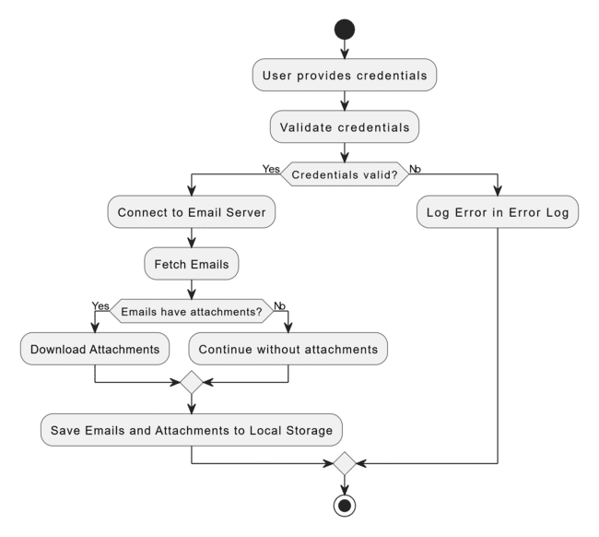
Functional Description
Payment Details: Extracts invoice number, dates, amount, and company name.
Classification: Detects emails with payment info.
Automation: Reduces manual effort in data extraction.
Accuracy: Ensures precise extraction from emails
Formatting: Displays details in a structured format.
Email Extraction Module

Slide 12
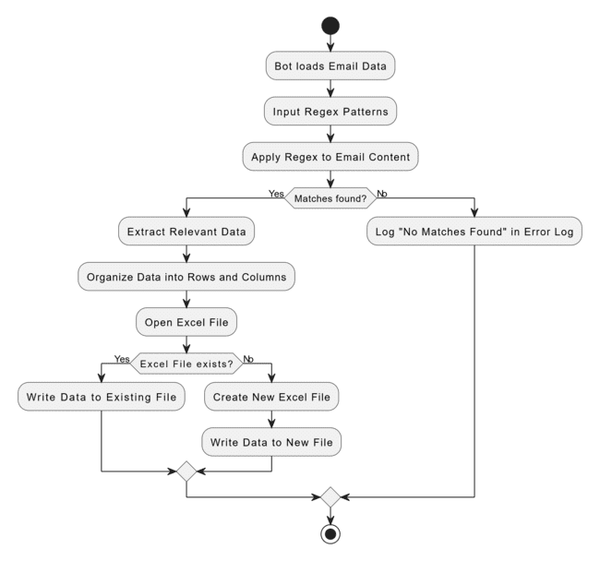
Functional Description
Regex and Excel Module
Regex Patterns: Extracts structured data (e.g., dates, IDs) from unstructured text with precision.
Excel Parsing: Reads specific rows/columns, processes large datasets programmatically.
Field Identification: Maps relevant fields dynamically from both text and sheets.
Data Integrity: Ensures consistency and accuracy during extraction.
Output Structure: Formats extracted data for seamless integration with other systems.

Slide 13
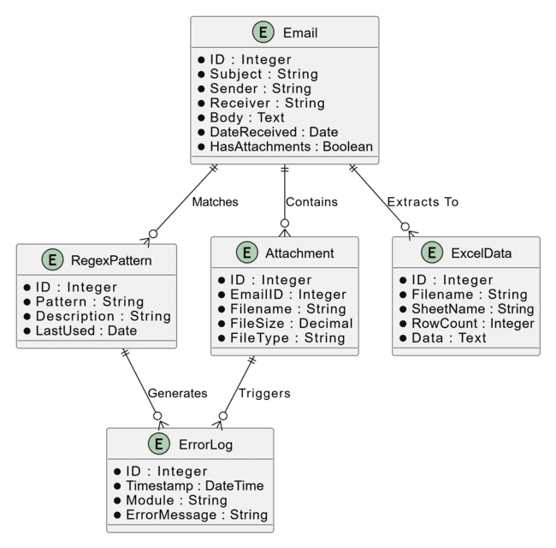
Table Design-ER DIAGRAM

Slide 14
Process Design
Main Process: Automate email handling through extraction, organization, and task management.
Subprocesses:
Email Classification: Scans emails for key phrases, categorizes into types (e.g., invoices, reminders).
Data Extraction:
  Regex: Extracts invoice details (numbers, dates, amounts).
  Excel: Parses spreadsheets for relevant data.
Action Assignment: Identifies tasks (e.g., due dates), assigns priorities.
Email Organization: Moves emails to folders, logs processed data.
Notification & Logging: Sends alerts for tasks, maintains data logs.
User Interaction: Provides a review interface, supports manual overrides.

Slide 15
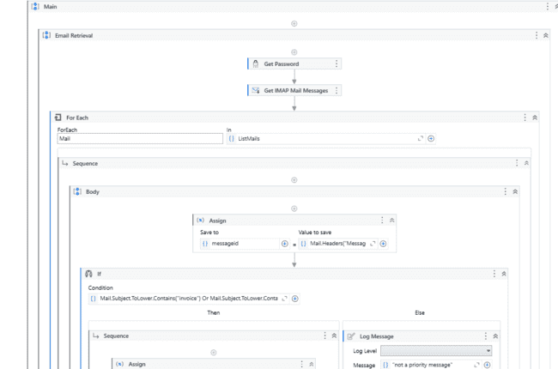
Implementation
The Email Extraction Module leverages regex for structured data extraction (e.g., invoice numbers, dates, amounts) and processes attachments like Excel sheets for field-specific data. It integrates seamlessly with email APIs to parse content, classify emails, and organize extracted details into a structured format for automated workflows or user review.

Slide 16
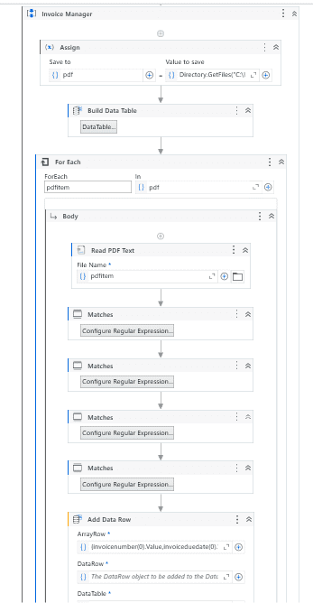
Implementation
The Regex and Excel Automator combines advanced regex patterns for precise data extraction from unstructured text with automated Excel parsing to process specific fields. It efficiently handles large datasets, mapping required data points and organizing outputs into structured formats for seamless integration with downstream workflows

Slide 17
Conclusions
MailMinder Bot is an intelligent solution designed to automate the entire process of email management. By leveraging advanced techniques like regex for text extraction and automated parsing of Excel files, MailMinder efficiently extracts important information such as invoice details, payment due dates, and more. The bot categorizes emails, assigns priorities, and organizes them into folders, streamlining workflows and reducing manual effort. This automation allows users to focus on critical tasks while ensuring that no important emails go unnoticed. MailMinder’s ability to automate repetitive tasks and maintain an organized email structure leads to enhanced productivity and accuracy in email handling.
In conclusion, MailMinder Bot provides an effective, automated approach to managing and processing emails, ensuring that essential tasks are completed with greater efficiency and minimal human intervention. It simplifies email management, improves workflow automation, and ultimately boosts productivity for users and organizations.

Slide 18
Future Enhancement
AI-Powered Classification: Integrating machine learning models for more accurate and dynamic email classification, allowing the bot to adapt to new types of emails and evolving user needs.
Multi-Language Support: Expanding the bot's ability to process emails in multiple languages, broadening its usability across diverse user bases.
Advanced Reporting: Adding more detailed reporting features, such as trends in email volume, priority tasks completed, and insights on email processing efficiency.
Integration with Other Platforms: Enabling seamless integration with other communication platforms like Slack, Teams, or CRM systems to manage not only emails but all types of communication within an organization.
User Customization: Allowing users to create custom extraction patterns or categories to tailor the bot's behavior to specific needs.

Slide 19
References
"Advanced Email Spam Detection: A Machine Learning Solution" (2022) explores the use of machine learning techniques to enhance email classification and spam detection. This paper presents hybrid approaches for handling spam, which could be adapted for email extraction tasks such as identifying important data from emails​
IEEE Xplore
.
"Machine Learning based Hybrid Approach for Email Spam Detection" (2022) proposes the use of a hybrid model combining multiple machine learning techniques for better email classification. It covers methods that could be useful for automating email management, including the extraction and categorization of email content​
IEEE Xplore
Zoho Mail's AI-Powered Assistant: Zoho offers a feature called Zia, which uses AI to analyze incoming emails and extract information based on predefined criteria, such as order details, customer requests, and invoice information. Zia's machine learning capabilities allow it to learn from patterns in emails and automatically categorize or route them​ar5iv
.

Slide 20
Queries

Slide 21
Demonstration

Slide 22
Thank You

